Slide 1

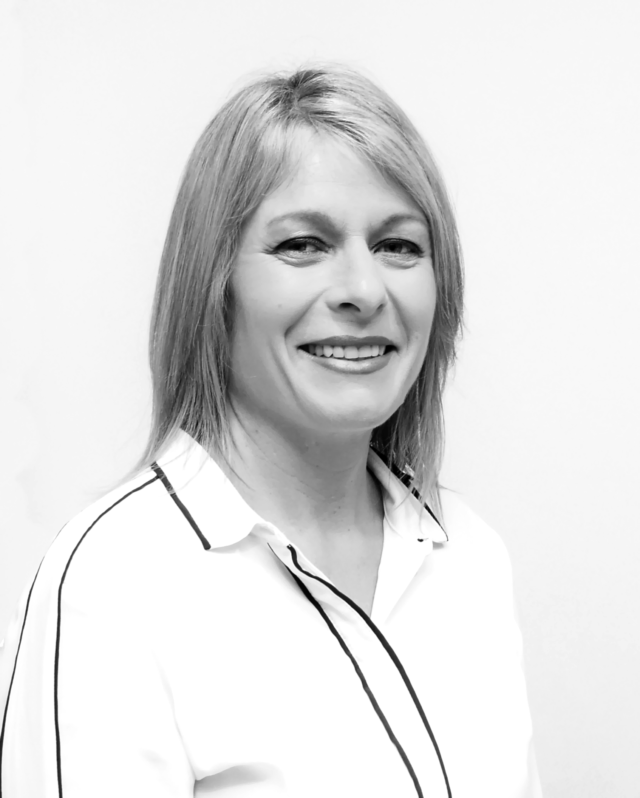
Cindy McGrath, Consultant
+64 (0) 211 917189 kauricontractors@outlook.com Website: www.kauricontractors.co.nz
Summary
A highly experienced Chartered Accountant, Project Manager, and Senior Business Analyst with over 20 years of experience in driving critical finance and regulatory initiatives for leading financial, manufacturing, and retail institutions, including HSBC, RBS, Credit Suisse, Carrefour, nib, Boldyn, Suncorp, and KPMG. I have a proven track record of delivering projects on time and within budget, with expertise in a range of project methodologies. With a strong combination of business acumen and leadership skills, I am skilled in coordinating cross-functional teams, aligning project objectives with organizational goals, and managing risk, resources, and stakeholder communication. I am committed to continuous improvement, with a solid background in process analysis, redesign, and implementation, and a specialist in identifying areas for optimization.
I leverage my analytical expertise and deep understanding of business processes to collaborate with stakeholders and execute strategies that drive productivity and deliver measurable business outcomes. I also have extensive experience assessing and implementing off-shoring and near-shoring opportunities, optimizing global partnerships.
A results-driven professional, I excel in dynamic, complex corporate environments, and am an effective communicator at all levels of management, consistently delivering high-quality results within tight deadlines.
Competencies
Structured Business Analysis & Project Management
MI & Reporting
Finance System Implementation
Off-shoring & Near-shoring
Cost Accounting & Analysis
Process Improvement
Change Management
Regulatory Compliance
Senior Stakeholder Management
Qualifications
Diploma in Information Systems, Auckland University
Bachelor of Business Studies, Massey University
Chartered Accountant, ICANZ
Prince 2 Practitioner
Agile PM
Agile PM
Sector Experience
Suncorp (2 years)
Project Manager within the Partnering Optimization and Acceleration and Momentum programs, who brought extensive experience in managing complex, international transitions. This included the successful transfer of call center and back-office operations from New Zealand to offshore partners. My expertise extends to Digital Transformation and Automation Management, where I led the implementation of a customer portal, online payments, and process automation, significantly enhancing both customer experience and operational efficiency. I successfully managed the Salesforce CRM implementation for Sales and Service frontline teams, contributing to improved workflows and productivity. I was responsible for the on-time delivery of 8 portfolio implementations within a 12-month period, establishing and managing Partnering Governance Structures, budgets, workstream resources, and execution plans, while overseeing monitoring, baseline management, and project closure. In this role, I coordinated cross-functional teams to achieve project objectives and realize key benefits, ensuring effective risk and issue management, resource allocation, and stakeholder communication. I am dedicated to continuous improvement, with a strong background in process analysis, redesign, and implementation, and a focus on identifying areas for improvement and optimization. A key strength of mine is fostering a culture of trust, accountability, and autonomy within project teams, empowering them to take ownership of their deliverables. I have played an instrumental role in managing both internal and external stakeholder relationships, ensuring alignment and driving successful project outcomes.
HSBC (5 years)
Project Manager and Senior Business Analyst within the Group Management Office, where I contributed to the successful delivery of multiple projects over a 5-year period, focusing on Regulatory, Management Information (MI), and Strategic Change programs. I played a key role in establishing governance structures and defining target operating models for Regulatory Change, MI, and Fast Close programs, while providing strategic recommendations for MI Reports and BI Dashboards. My involvement spanned the entire project lifecycle, from analysis to transition, including the preparation of business cases, investment summaries, plans, and strategy documents. I also developed business and functional requirements, interface specifications, test scripts, and training documentation. I worked on data migrations, data transformation, accounting schematics, and global reference data, ensuring smooth process transitions. I led the preparation of feasibility studies and assessments for off-shoring and near-shoring opportunities, collaborating closely with service centers in India and Poland as well as Regional Business Leads to manage successful migrations. Additionally, I defined, reviewed, and published global standard processes and procedures to support the efficient deployment of the Finance Transformation Platform, driving the standardization of finance functions through streamlined, common global processes.
BAI Communications and Boldyn Networks
Business Consultant on the Torres Programme, where I played a pivotal role in integrating 8 businesses across 4 technology platforms across multiple countries, while also managing the separation of the Australian business, divesting companies, and overseeing the rebranding process. I was responsible for coordinating all business and technology requirements, ensuring financial management throughout the integration, separation, and transition phases. I led the successful implementation of both IT and business systems, establishing and defining governance structures, operating models, plans, and requirements. Additionally, I oversaw process design, development, testing, and delivery, ensuring a smooth transition and alignment with organizational goals..
RBS (1 year)
Business Consultant within the Non-Core COO Division, responsible for preparing quarterly Major Project Review Committee (MPRC) presentation packs and monthly GBM and COO Service statements for Senior Management reviews. These reports included in-depth analysis and commentary on three key programs: Country & Asset Disposals, Portfolio & Business Disposals, and Infrastructure and Governance. I provided the Non-Core Executive Team with detailed forecasts, execution cost analysis, and financial reports. This included preparing cost and headcount run-off analysis and overseeing the review of restructuring costs and asset disposals. Additionally, I conducted review and challenge sessions with senior management to ensure accurate financial tracking and alignment with business objectives.
Global leaders in Strategic Change and Finance Transformation

